Slide 1
Decision-Making in Depression: Ventromedial Prefrontal Cortex (vmPFC) Connectivity in Eating Disorders
Brenna Bray
March 24, 2017
http://www.stop-binging.com/wp-content/
uploads/2016/04/Long-term-effects-of-bulimia.jpg
https://www.organicfacts.net/home-remedies/home-remedies-for-anorexia.html

Slide 3
Central Coherence:
Ability to “see the big picture”
Set-Shifting:
Cognitive flexibility, “task switching”

Slide 4
Depression in BED and AN
(Aloi et al. 2015)

Slide 5
Reduced Neuropsychological Functioning in BED and AN
Iowa Gambling Task
(decision-making)
Hayling Sentence Completing Test
(response speed & suppression)
Trail-Making Task
(task-switching)
Wisconsin Card-Sorting Test
(Set-shifting)
Rey-Osterrieth Complex Figure Test
(Attention, planning, working memory)
(Aloi et al. 2015)

Slide 6
Iowa Gambling Task: Impulsive Decision-Making
2 “bad” decks with high gains/losses
(losses > gains overall)
2 “good” decks with low gains/losses
(gains > losses overall)
Controls sample from both decks, choose “good decks” after ~50 trials
http://editthis.info/psy3242/File:Decks.jpg

Slide 7
Iowa Gambling Task: Impulsive Decision-Making
Assessment of decision-making ability:
- in uncertainty
- based on emotion-guided evaluation
Indicates risk preference
Indicates reward/penalty responses
http://editthis.info/psy3242/File:Decks.jpg

Slide 8
Patients with Anorexia Nervosa (AN) and Binge Eating Disorder (BED) performed worse than Healthy Controls (HC) on Iowa Gambling Task (IGT)
Aloi et al. Decision making, central coherence and set-shifting… BMC Psychiatry (2015) 15:6

Slide 9
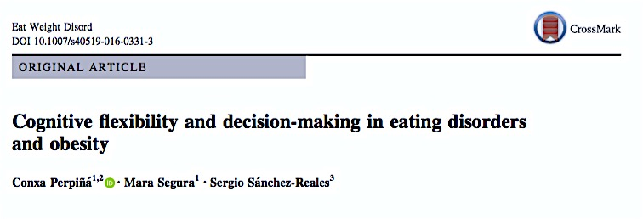

Slide 10
Neuropsychological Deficits in Eating Disorders & Obesity
IGT: Iowa Gambling Task
Mean and SD in parentheses. *** p<0.001. n²p effect size.
ANR: Restiricting-type anorexia nervosa. ED.AN: Eating disorder not otherwise specified anorexia nervosa type. BP-G: Binging/purging group.
OB: Obese group. HCG: Healthy comparison group. IGT Iowa Gambling Task.
Perpina et al. Cognitive flexibility and decision-making in eating disorders… Eat Weight Disord (2016)

Slide 11
Depression in Eating Disorders & Obesity
BDI: Beck Depression Inventory
IGT: Iowa Gambling Task
Mean and SD in parentheses. * p<0.05, **p<0.01, *** p<0.001. F* Fbrown-Forsythe.
ANR: Restiricting-type anorexia nervosa. ED.AN: Eating disorder not otherwise specified anorexia nervosa type. BP-G: Binging/purging group.
OB: Obese group. HCG: Healthy comparison group. BDI: Beck Depression Inventory.
Perpina et al. Cognitive flexibility and decision-making in eating disorders… Eat Weight Disord (2016)

Slide 12
Correlation between Depression and Decision-Making
*p<0.05, **p<0.01. • IGT: Iowa Gambling Task. • BDI: Beck Depression Inventory.
Perpina et al. Cognitive flexibility and decision-making in eating disorders… Eat Weight Disord (2016)

Slide 13
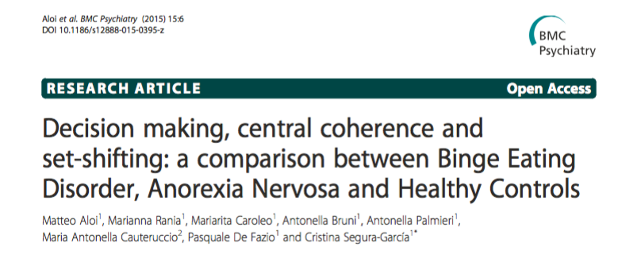
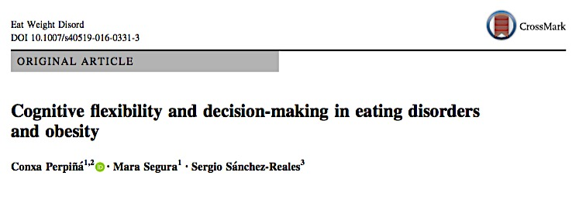
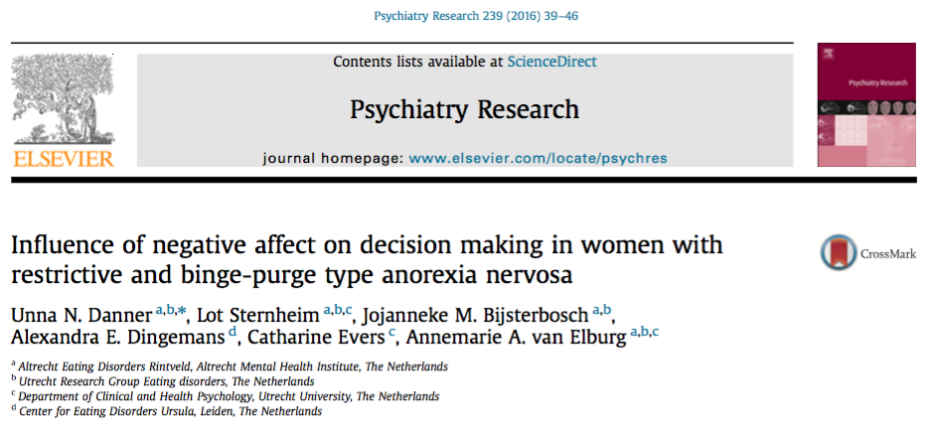

Slide 14
Iowa Gambling Task: Impulsive Decision-Making
Assessment of decision-making ability:
- in uncertainty
- based on emotion-guided evaluation
Indicates risk preference
Indicates reward/penalty responses
http://editthis.info/psy3242/File:Decks.jpg

Slide 15
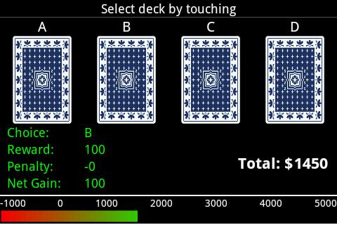
Iowa Gambling Task: Impulsive Decision-Making
Controls sample from both decks, choose “good decks” after ~50 trials
Orbitofrontal cortex (OFC) damage: Stick with ”bad” decks, despite recognizing losses (Bechara et al., 1997)
Ventromedial prefrontal cortex (vmPFC) dysfunction: Choose immediate gains, despite higher losses (Bechara et al., 2000)
http://img.phone.baidu.com/public/uploads/store_1/c/4/0/a095fa525df600bc1fa59b2c6b67c437.jpeg

Slide 16
Somatic Marker Hypothesis
Somatic Marker:
Bodily feeling associated with emotion
Stored & processed in vmPFC (Damasio, 1994)
Somatic Marker Hypotheses:
vmPFC damage impairs ability to:
Express and experience appropriate emotions
Organize/plan behavior, learn from previous mistakes (without affecting working memory or attention)
https://en.wikipedia.org/wiki/Somatic_marker_hypothesis

Slide 17
Somatic Marker Hypothesis
Somatic Marker:
Bodily feeling associated with emotion
Stored & processed in vmPFC (Damasio, 1994
Somatic Marker Hypotheses:
Emotions influence ability to make fast, rational decisions
in complex and uncertain situations
vmPFC enables ability to use past emotions and experiences to guide future behavior in decision-making
https://en.wikipedia.org/wiki/Somatic_marker_hypothesis

Slide 18
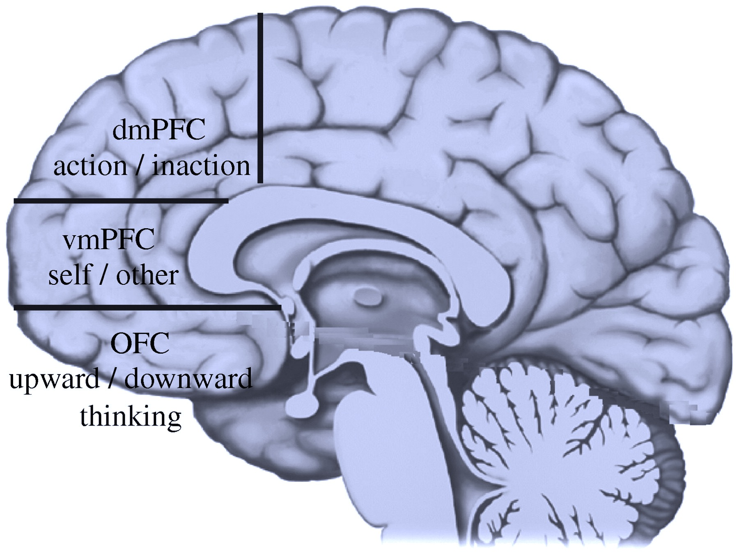
vmPFC: Orbitomedial surface of frontal lobe cortex
Above: vmPFC in humans (Barbey et al., 2009)
Right (Top): Lat. and med. PFC in monkey (Öngür & Price, 2000)
Right (Bottom): VMPFC and OFC in monkey (Bouret & Richmond, 2010)
Notes:
vmPFC – cortex on orbital and medial surface of the frontal love
OB= Olfactory Bulb
SMA= Supplementary Motor Area
MFr = Middle Frontal (rostral) gyrus?
MFc = Middle Frontal (caudal) gyrus?
FPC = frontopolar cortex (Broodman’s area 10?) Decision-making
M1 = Primary Motor
LOT= lateral olfactory tract
PrCO= precentral opercular area

Slide 19
vmPFC Function
vPFC Encodes value of task events
vmPFC emphasizes internally driven motivational signals
vmPFC neurons: sensitive to internal factors (satiety)
OFC neurons: sensitive to external factors (environmental, visual cues)
Bouret & Richmond. Ventromedial and orbital PFC neurons differentially encode internally and externally driven motivational values in monkeys. J Neurosci, 2010.
Images: Top: Barbey et al., 2009; Bottom: Bouret & Richmond, 2010

Slide 20
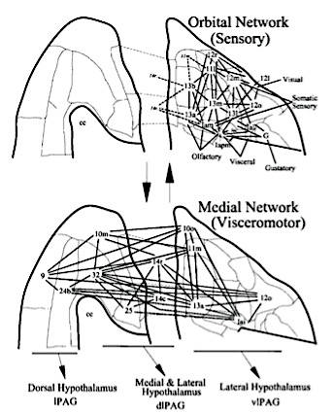
vmPFC Connectivity: vmPFC & OFC
Top: VMPFC and OFC in monkey (Bouret & Richmond, 2010)
Bottom: Lat. and med. PFC in monkey (Öngür & Price, 2000)
Orbital and Medial Networks interact through vm corner of frontal lobe. OFC receives & integrates sensory input. vmPFC functions as visceromotor system by projecting to hypothalamus and periquaeductal gray (Öngür & Price, 2000).
Notes:
vmPFC – cortex on orbital and medial surface of the frontal love
OB= Olfactory Bulb
SMA= Supplementary Motor Area
MFr = Middle Frontal (rostral) gyrus?
MFc = Middle Frontal (caudal) gyrus?
FPC = frontopolar cortex (Broodman’s area 10?) Decision-making
M1 = Primary Motor
LOT= lateral olfactory tract
PrCO= precentral opercular area

Slide 21
vmPFC Function & Connectivity
Sensory Integration
Sensory afferents from OFC
Visceral Function: Hypothalamus
Modulates autonomic activity
Responds to internal (visceral) cues
Emotional Processing: Limbic Regions
Subiculum
Amygdala
Perirhinal & entorhinal cortex
Reward Processing: Nac
Encodes value of task events
Orbital and Medial Networks interact through vm corner of frontal lobe. OFC receives & integrates sensory input. vmPFC functions as visceromotor system by projecting to hypothalamus and periquaeductal gray (Öngür & Price, 2000).

Slide 22
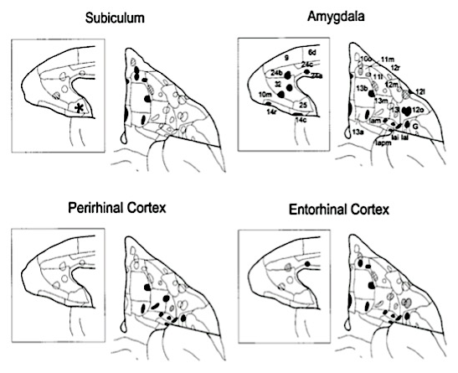
vmPFC Function & Connectivity
Sensory Integration
Sensory afferents from OFC
Visceral Function: Hypothalamus
Cortical influence over visceral function
Modulates autonomic activity
Emotional Processing: Limbic Regions
Subiculum
Amygdala
Perirhinal & entorhinal cortex
Reward Processing: Nac
Encodes value of task events
Outlines on projections of OFC and vmPFC indicate retrograde axonal tracer injections. Filled outlines produced large limbic labeling. Hatched outlines: less labeling. * indicates projections found by others. Fig from Öngür & Price, 2000.
Notes:
SUB: stress responses
AMYG: fear and anxiety
Perirhinal cortex: visual perception & memory
Entorhinal cortex: neural map of spatial environment

Slide 23
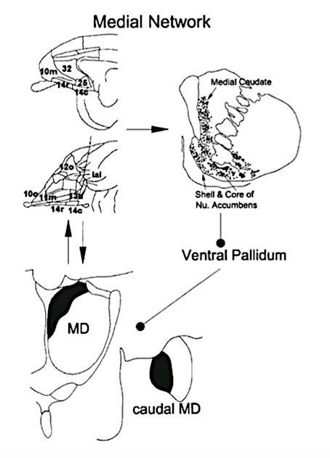
vmPFC Function & Connectivity
Sensory Integration
Sensory afferents from OFC
Visceral Function: Hypothalamus
Cortical influence over visceral function
Modulates autonomic activity
Emotional Processing: Limbic Regions
Subiculum
Amygdala
Perirhinal & entorhinal cortex
Reward Processing: Nac
Encodes value of task events
vmPFC projects to the vm striatum, including medial caudate nucleus, nucleus accumbens (core & shell), and ventral putamen, with interconnections to dorsomedial and caudal mediodorsal thalamic nucleus (MDm). The striatal and thalamic regions are connected via the ventral pallidum. Öngür & Price, 2000.
Notes:
Medial caudate nucleus
motor function: spatial mnemonic processing, directed movements
cognitive function: goal-directed action, memory, learning, sleep, emotion, language, threshold control
NacC&S (reward value and obtaining)
Dorsomedial thalamic nucleus: pain processing
Mediodorsal

Slide 24
vmPFC Function & Connectivity
vmPFC → Nucleus Accumbens (Nac)
Antidepressant Effect
Enables Appetitive Conditioning
Process by which new rewards are learned and acquire motivational salience
Reward-related hedonic behavior
Hedonic tone: degree of pleasant/unpleasantness associated with a given subject/state/circumstance
AKA: positive/negative valence (intrinsic attractive/aversiveness)
(Steinberg et al., 2015 & Deisseroth, 2014 as cited in Young et al., 2016)
vmPFC projects to the vm striatum, including medial caudate nucleus, nucleus accumbens (core & shell), and ventral putamen, with interconnections to dorsomedial and central mediodorsal thalamic nucleus (MDm). The striatal and thalamic regions are connected via the ventral pallidum (Öngür & Price, 2000).
Notes:
Appetitive Conditioning: process through which new rewards are learned and acquire their motivational salience. Although it has the same evolutionary survival significance as aversive conditioning, appetitive conditioning has rarely been studied in humans

Slide 25
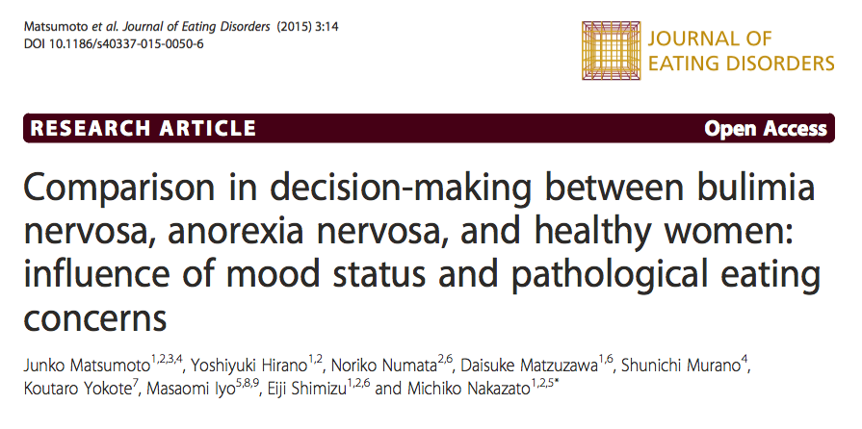

Slide 26
Methods:
Self-Report Questionnaires:
Pathological eating/weight concerns
Attitude to feelings
Self-Report Questionnaires:
Eating Disorder Examination Questionnaire (EDE-Q)
Bulimia Investigatory Test, Edinburgh (BITE)
Eating Disorders Inventory (EDI)
Maudsley Obsessive-Compulsive Inventory (MOCI)
Hospital Anxiety and Depression Scale (HADS)
Toronto Alexithymia Scale (TAS)
Recruitment: age-matched females:
Anorexia Nervosa (AN, n=22)
Bulimia Nervosa (BN, n=36)
Healthy Controls (HC, n=51)
Clinical Assessment:
DSM-IV & Mini-International-Neuropsych Interview
Comorbidities & Medications
Iowa Gambling Task (IGT):
Decision-Making Abilities

Slide 27
Depression in Anorexia Nervosa (AN) and Bulimia Nervosa (BN)
BMI: body mass index
TAS-20: Toronto Alexithymia Scale
Alexithymia: inability to identify and describe one’s emotions
EDE-Q: Eating Disorders Exam. Questionnaire
EDE-Qg: global score
EDE-Qr: restricting
EDE-Qe: eating concern
EDE-Qw: weight concern
EDE-Qs: shape concerns
HADS: Hospital Anxiety and Depression Scale
HADSa: Anxiety
HADSd: Depression
BITE: Bulimia Investigatory Test, Edinburgh
BITEsas: symptom scale
BITEss: severity scale
MOCI: Maudsley Obsessive-Compulsive Inventory
EDI-2: Eating Disorders Inventory 2
Dysthymia: “neurotic/chronic depression”
Somtaform: mental illness causing ≤1 bodily symptoms (GI complaints, neurological problems, pain, sexual sx)
SSRI: Selective Serotonin Reuptake Inhibitors
Matsumoto et al. Comparison in decision-making between BN, AN, and HC… J Eating Disorders (2015) 3:14

Slide 28
Reduced decision-making ability and learning in Bulimia Nervosa
Figure 1: Strategy of Iowa Gambling Task, as total number of “Advantageous” minus “Disadvantageous” cards selected in each block of 20 cards.
AN: Anorexia Nervosa
BN: Bulimia Nervosa
HC: Healthy Controls.
A significant difference between BN and HC was indicated (p<0.05)
Matsumoto et al. Comparison in decision-making between BN, AN, and HC… J Eating Disorders (2015) 3:14

Slide 29
Failure to Learn Advantageous Decision-Making in AN & BN
Compared to HC, “AN and BN… failed to learn advantageous decision-making until the end of the task” (Matsumoto et al., 2006)
Figure 1: Total number of “Advantageous” minus “Disadvantageous” cards selected in each block of 20 cards for AN, BN, & HC.
Matsumoto et al. Comparison in decision-making between BN, AN, and HC… J Eating Disorders (2015) 3:14

Slide 30
Failure to Learn Advantageous Decision-Making in AN & BN
Compared to HC, “AN and BN… failed to learn advantageous decision-making until the end of the task” (Matsumoto et al., 2006)
Somatic Marker Hypotheses:
vmPFC enables ability to use past emotions and experiences to guide future behavior in decision-making
vmPFC damage impairs ability to organize/plan behavior, learn from previous mistakes (without affecting working memory or attention)
Figure 1: Total number of “Advantageous” minus “Disadvantageous” cards selected in each block of 20 cards for AN, BN, & HC.
Matsumoto et al. Comparison in decision-making between BN, AN, and HC… J Eating Disorders (2015) 3:14

Slide 31
Failure to Learn Advantageous Decision-Making in AN & BN
Compared to HC, “AN and BN… failed to learn advantageous decision-making until the end of the task” (Matsumoto et al., 2006)
Findings suggest: “pathological concerns” caused patients to “[ignore] long-term negative consequences,” as observed in the IGT, “which may have led to impaired decision-making ability in the final block...” (Matsumoto et al., 2016).
Pathological: related to disease; obsessive, compulsive (google.com)
Could be somatic in EDs?
Figure 1: Total number of “Advantageous” minus “Disadvantageous” cards selected in each block of 20 cards for AN, BN, & HC.
Matsumoto et al. Comparison in decision-making between BN, AN, and HC… J Eating Disorders (2015) 3:14

Slide 32
Failure to Learn Advantageous Decision-Making in AN & BN
“There is a striking resemblance between the IGT performance of the patients and their real-life pathological behaviors, in which they have a tendency to reduce their food intake and/or refuse to eat, or in contrast to this pattern, repetitively overeating and purging, ignoring long-term negative consequences.”
Figure 1: Total number of “Advantageous” minus “Disadvantageous” cards selected in each block of 20 cards for AN, BN, & HC. Image and quotation from Matsumoto et al., 2015.
http://www.stop-binging.com/wp-content/uploads/2016/04/Long-term-effects-of-bulimia.jpg

Slide 33
Caveat
AN patients failed to reach a significant difference in decision-making compared to HC
Smaller sample size (AN=22; BN=36; HC=51)
Fewer comorbidities => better decision-making?
2 in AN (somatoform & anxiety)
5 in BN (3 dysthymia, 1 panic, 1 EtOH)
Figure 1: Total number of “Advantageous” minus “Disadvantageous” cards selected in each block of 20 cards for AN, BN, & HC. Image and quotation from Matsumoto et al., 2015.
https://www.organicfacts.net/home-remedies/home-remedies-for-anorexia.html

Slide 34
7 Variables Predicting Decision-Making Performance
7 Predictive Variables for Decision Making Performance (IGT Score in 3rd block)
Variable | Beta | T | P-value
Education (Years) | 0.77 | 4.40 | 0.00
EDE-Qr (Restricting) | 1.58 | 4.45 | 0.00
HADS (Depression) | 1.44 | 4.65 | 0.00
BITEsas (Symptom Scale) | -1.8 | -5.01 | 0.00
HADS (Anxiety) | -0.69 | -2.69 | 0.01
EDI-2 (Eating Disorders Inventory) | -0.81 | -2.62 | 0.01
BITEss (Bulimia Severity) | -0.51 | -2.33 | 0.03
N= 109; R²=0.556; adjusted R²=0.388; SE=6.036
EDE-Qr: Restricting subscale of Eating Disorder Examination Questionnaire
HADS: Hospital Anxiety & Depression Scale
HADSd: Depression
HADSa: Anxiety
BITE: Bulimia Investigatory Test, Edinburgh
BITEss: Severity scale
BITEsas: Symptom scale
EDI-2: Eating Disorders Inventory-2
Matsumoto et al. Comparison in decision-making between BN, AN, and HC… J Eating Disorders (2015) 3:14

Slide 35
7 Variables Predicting Decision-Making Performance
7 Predictive Variables for Decision Making Performance (IGT Score in 3rd block)
Variable | Beta | T | P-value
Education (Years) | 0.77 | 4.40 | 0.00
EDE-Qr (Restricting) | 1.58 | 4.45 | 0.00
HADS (Depression) | 1.44 | 4.65 | 0.00
BITEsas (Symptom Scale) | -1.8 | -5.01 | 0.00
HADS (Anxiety) | -0.69 | -2.69 | 0.01
EDI-2 (Eating Disorders Inventory) | -0.81 | -2.62 | 0.01
BITEss (Bulimia Severity) | -0.51 | -2.33 | 0.03
N= 109; R²=0.556; adjusted R²=0.388; SE=6.036
Regression analyses revealed 7 predictive factors for the third block of IGT (when HCs sample more from “Advantageous” decks)
“…Mood status (anxiety or depression), in addition to the pathological eating/weight concerns [were detected as predictive] of decision-making”
Matsumoto et al. Comparison in decision-making between BN, AN, and HC… J Eating Disorders (2015) 3:14

Slide 36
Depressed Mood Predicts Decision-Making (in ED and HCs)
Both depression and anxiety were found to be predictors of better decision-making
↑HADS score: ↑ depression/anxiety
↑ IGT Score: better decision-making
R² = 0.556; adjusted R² = 0.388
Emotional states may impact decision-making in EDs and in HC
Negative-emotional states:
↑ urge to eat, ↑ # of binges (Zeeck et al as cited in Matsumoto et al., 2015)
7 Predictive Variables for Decision Making Performance (IGT Score in 3rd block)
Variable | Beta | T | P-value
Education (Years) | 0.77 | 4.40 | 0.00
EDE-Qr (Restricting) | 1.58 | 4.45 | 0.00
HADS (Depression) | 1.44 | 4.65 | 0.00
BITEsas (Symptom Scale) | -1.8 | -5.01 | 0.00
HADS (Anxiety) | -0.69 | -2.69 | 0.01
EDI-2 (Eating Disorders Inventory) | -0.81 | -2.62 | 0.01
BITEss (Bulimia Severity) | -0.51 | -2.33 | 0.03
N= 109; R²=0.556; adjusted R²=0.388; SE=6.036
Matsumoto et al. Comparison in decision-making between BN, AN, and HC… J Eating Disorders (2015) 3:14
Notes:
“

Slide 37
Depressed Mood Predicts Decision-Making (in ED and HCs)
Both depression and anxiety were found to be predictors of better decision-making
↑HADS score: ↑ depression/anxiety
↑ IGT Score: better decision-making
R² = 0.556; adjusted R² = 0.388
Emotional states may impact decision-making in EDs and in HC
Negative-emotional states:
↑ urge to eat, ↑ # of binges (Zeeck et al as cited in Matsumoto et al., 2015)
“Network Theory of Affect:”
Affective nodes (central units) can be:
semantic (with straightforward meaning)
or affective (with emotional meaning)
May confirm Zeeck et al.’s findings
Matsumoto et al. Comparison in decision-making between BN, AN, and HC… J Eating Disorders (2015) 3:14
Notes:
“

Slide 38
Depressed Mood Predicts Decision-Making (in ED and HCs)
Both depression and anxiety were found to be predictors of better decision-making
↑HADS score: ↑ depression/anxiety
↑ IGT Score: better decision-making
R² = 0.556; adjusted R² = 0.388
Emotional states may impact decision-making in EDs and in HC
Negative-emotional states:
↑ urge to eat, ↑ # of binges (Zeeck et al as cited in Matsumoto et al., 2015)
“Network Theory of Affect:”
Affective notes (central units) can be:
semantic (with straightforward meaning)
or affective (with emotional meaning)
May confirm Zeeck et al.’s findings
Somatic Marker Hypothesis:
Somatic Marker: body feeling associated with emotion
Stored & processed in vmPFC (Damasio, 1994)
vmPFC damage impairs ability to:
Experience appropriate emotions
Plan behavior, learn from previous mistakes
Matsumoto et al. Comparison in decision-making between BN, AN, and HC… J Eating Disorders (2015) 3:14
Notes:
“

Slide 39
Further Discussion: The Serotonin System
Significant difference in IGT performance between BN and HC in 4th and final block when controlling for SSRIs
Suggests influence of the serotonin system in decision-making
Dysregulation of cortical and limbic serotonin circuits implicated in anxiety, eating behavior, and body image symptoms (Kaye et al., 2005 as cited in Matsumoto et al., 2015)
Alterations in serotonin systems may influence mood and decision-making processes in EDs (Matsumoto et al., 2015)
Figure 1: Total number of “Advantageous” minus “Disadvantageous” cards selected in each block of 20 cards for AN, BN, & HC. Image and quotation from Matsumoto et al., 2015.
Notes:
“This depends on whether the vmPFC interprets stress as controllable or uncontrollable”

Slide 40
Further Discussion: The Serotonin System
Significant difference in IGT performance between BN and HC in 4th and final block when controlling for SSRIs
Suggests influence of the serotonin system in decision-making
Dysregulation of cortical and limbic serotonin circuits implicated in anxiety, eating behavior, and body image symptoms (Kaye et al., 2005 as cited in Matsumoto et al., 2015)
Alterations in serotonin systems may influence mood and decision-making processes in EDs (Matsumoto et al., 2015)
vmPFC
Amygdala
vmPFC
Amygdala
Negative emotional bias in depressed patients is caused by a vmpFC-induced increase in amygdala activation, which is dependent on stress controllability. (Queensland Brain Institute, https://qbi.uq.edu.au/brain/brain-diseases/depression/depression-and-brain)
Notes:
“This depends on whether the vmPFC interprets stress as controllable or uncontrollable”

Slide 41
Could vmPFC Dysfunction Underlie Depression and Decision-Making Deficits (in ED and HC)?
vmPFC interacts with the orbital sensory network, functions as visceromotor system (through reciprocal connections with hypothalamus), and induces top-down control over limbic and reward systems.
Left: vmPFC in humans (Barbey et al., 2009). Center & Right: vmPFC projections and connections in monkey (Öngür & Price, 2000).

Slide 42
Could vmPFC Dysfunction Link Depression and Decision-Making Deficits in Eating Disorders?
Measure | Anorexia N (n=22) |  | Bulimia N (n=36) |  | Healthy C (N=51) |  | P-value | Post hoc
 | Mean | SD | Mean | SD | Mean | SD
IGT (Total) | 10.48 | 25.53 | 7.50 | 27.09 | 15.06 | 20.99 | 0.35 | ns
IGT (block 5) | 2.67 | 10.11 | 2.29# | 8.73 | 7.35 | 9.29 | 0.03 | BN<HC
HADSd depression | 9.18* | 4.79 | 11.32* | 4.43 | 3.37 | 3.14 | 0.00 | AN>HC, BN>HC
HADSa anxiety | 11.06* | 4.29 | 12.00* | 3.87 | 4.61 | 3.39 | 0.00 | AN>HC, BN>HC
EDE-Qg (global) | 3.23* | 1.60 | 3.97* | 1.26 | 1.07 | 0.89 | 0.00 | AN>HC, BN>HC
EDE-Qe (eating) | 3.39* | 1.70 | 3.72* | 1.63 | 0.47 | 0.64 | 0.00 | AN>HC, BN>HC
Comorbidity | Somatoform disorder (1) |  | Dysthymia (3) |  | *p=0.00 vs controls |  | #p=0.03 vs controls
Matsumoto et al. Comparison in decision-making between BN, AN, and HC… J Eating Disorders (2015) 3:14

Slide 43
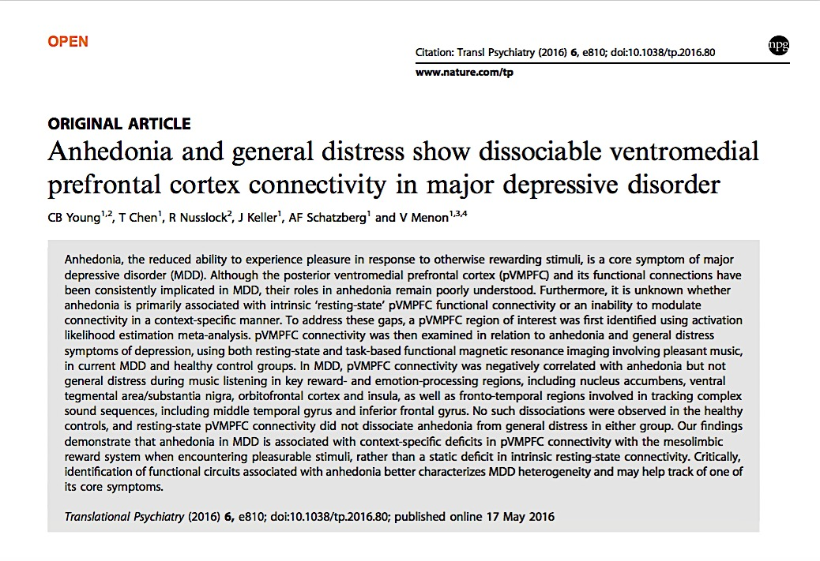

Slide 44
Anhedonia
Requisite MDD symptom (or depressed mood)
“Diminished interest or pleasure in response to rewarding stimuli”
Pelizza & Ferrari. Anhedonia in …MDD: state or trait? Ann Gen Psychiatry 2009 as cited in Young et al., 2016
“Impairments in motivation and reward-based decision-making”
Treadway et al. Effort-based decision-making in MDD: translational model of motivational anhedonia. Abn Psych 2012; Pizzagalli et al., 2005 as cited in Young et al., 2016
Associated with reward-processing deficits

Slide 45
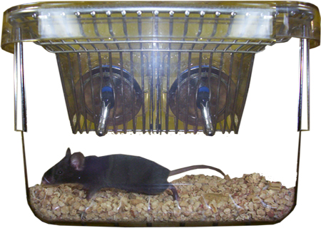
Anhedonia
Diminished interest or pleasure in response to rewarding stimuli
Impaired reward-processing & reward-based decision-making
http://neurobehaviour.lunenfeld.ca/DEFAULT.ASP?page=Depression
http://skepchick.org/wp-content/uploads/2013/12/mr-sunshine-2.jpg

Slide 46
Anhedonia
Diminished interest or pleasure in response to rewarding stimuli
Impaired reward-processing & reward-based decision-making
http://neurobehaviour.lunenfeld.ca/DEFAULT.ASP?page=Depression
Strekalova et al., …Methodologies of chronic stress paradigm… Behav Brain Funct 2011.

Slide 47
Anhedonia
Diminished interest or pleasure in response to rewarding stimuli
http://neurobehaviour.lunenfeld.ca/DEFAULT.ASP?page=Depression
Strekalova et al., …Methodologies of chronic stress paradigm… Behav Brain Funct 2011.

Slide 48
Neural Underpinnings of Anhedonia
Reduced activity in vmPFC
Involved in reward processing & monitoring
Posterior vmPFC implicated in depression
central to depression pathophysiology
(BA25/32 pl subdivision)
Barbey, Krueger, & Grafman., Phil Transac of Royal Soc B. 2009.
http://rstb.royalsocietypublishing.org/content/364/1521/1291

Slide 49
Task-modulation vs intrinsic resting state functioning:
Is anhedonia (in [depression, MDD]) “associated with [aberrant] intrinsic resting-state brain connectivity or an inability to modulate brain responses in a context-specific manner?”
Barbey, Krueger, & Grafman., Phil Transac of Royal Soc B. 2009.
http://rstb.royalsocietypublishing.org/content/364/1521/1291
Notes:
Aberant = abnormal

Slide 50
Young et al., 2016: Research Questions
Are there specific neural pathways associated with anhedonia (during activity and/or at rest) in patients with depression (MDD)?
Are anhedonic connectivity patterns associated with distinct vmPFC subregions (posterior vmPFC, BA25/32pl)?
Are MDD anhedonic pathways also present in healthy controls?

Slide 51
Young et al., 2016: Participants
Recruitment (advertisement & payment):
Major Depressive Disorder (MDD, n=21)
Healthy Controls (HC, n=22)
Significant age difference (but not gender)
MDD=46 y/o avg; HC=35 y/o avg)
7/21 pts with comorbidities: 6x dysthymia &/or anxiety; 1: dysthymia + anorexia
13 pts taking medications (antidepressants, etc)
Structured Clinical Interview:
DSM-IV, Hamilton Rating Scale for Depression (HDRS)
http://i.huffpost.com/gen/2063534/images/o-DEPRESSION-facebook.jpg

Slide 52
Young et al., 2016: Methods
Resting State fMRI (17 MDD, 16 CON)
Resting, eyes closed (8 min)
Clinical Assessment
Pre-Music-Listening Scan Assessment:
Hamilton Rating Scale for Depression (HDRS)
Mood & Anxiety Symptom Questionnaire (MASQ)
General Distress Depressive Symptoms (MASQ-GDD)
Anhedonic Depression (MASQ-AD)
High positive affect factor (MASQ-AD-PA)
PA=depression-specific, vs anxiety-specific
Also: General Distress-Anxiety & Anxious Arousal
fMRI music-listening task:
3 classical music pieces - familiar and pleasant
Enhance VTA-Nac DA release
3 classical music pieces - unfamiliar
Scrambled auditory stimuli (control)
Presented for 22-28 s with 22s rest interval
Button press at start & end of each musical epoch
Post-Music-Listening Scan:
participants rate music and scrambled pieces
1-9 Likert Scale:
Exciting-calm • Happy-sad
Unpleasant-pleasant • Moving-unmoving
Tense-relaxed • Boring-interesting
Annoying-unannoying • Unfamiliar-familiar
Angry-peaceful

Slide 53
fMRI Acquisition & Analyses:
Meta-analysis to identify a pVMPFC region implicated in mood and anxiety disorders
Examined task-based intrinsic connectivity related to anhedonia and general distress in MDD and HC patients.
gPPI: generalized form of psychophysiological interaction
PPI (psychophysiological interaction): enables task-dependent connectivity analysis, configured to assess connectivity differences between 2 task conditions¹
Shows how brain regions interact in a task-dependent manner¹
gPPI accommodates >2 task conditions in the same PPI model by spanning entire experimental space¹
Confirmatory and partial correlation analyses used to confirm robustness of findings
(Young et al., 2016)

Slide 54
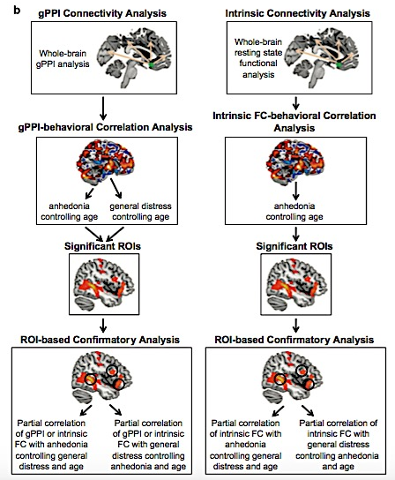
fMRI Acquisition & Analyses:
Meta-analysis: pVMPFC “mood region”
Task-based & intrinsic connectivity related to anhedonia & general distress in MDD and HCs.
gPPI: generalized form of PPI (psychophysiological interaction)
Data analysis model (like PPI)
Enables task-dependent connectivity analysis
of connectivity differences between >2 task conditions
by spanning an entire experimental space¹
Shows how brain regions interact in a task-dependent manner¹
¹McLaren, Ries, Xu, & Johnson, Neuroimage, 2010.
(Young et al., 2016)

Slide 55
fMRI Acquisition & Analyses:
Meta-analysis: pVMPFC “mood region”
Task-based & intrinsic connectivity related to anhedonia & general distress in MDD and HCs.
FC: Functional connectivity; ROI: Region of Interest
(Young et al., 2016)

Slide 56
Music Stimulus Ratings
MDD and HD did not differ in ratings for Music or Scrambled
MASQ-AD-PA was negatively correlated with music pleasantness ratings
MASQ-AD-PA: Depressive Anhedonia
In healthy controls
Not in MDD
https://islandpen.files.wordpress.com/2012/10/teen_music_1.jpg

Slide 57
Brain Activation During Music Listening
X
Camus, A. (2017). Anhedonia, A Neural Condition which prevents you to experience pleasure when listening to music. Obtained online at: http://rocknycliveandrecorded.com/anhedonia-a-neural-condition-which-prevents-you-to-experience-pleasure-when-listening-to-music.html
Young et al. (2016). Anhedonia and vmPFC connectivity in MDD. Transl Psychiatry

Slide 58
Brain Activation During Music Listening
X
NAC activation assessed as a priori ROI:
R Nac: significant activation (not left)
Camus, A. (2017). Anhedonia, A Neural Condition which prevents you to experience pleasure when listening to music. Obtained online at: http://rocknycliveandrecorded.com/anhedonia-a-neural-condition-which-prevents-you-to-experience-pleasure-when-listening-to-music.html
Young et al. (2016). Anhedonia and vmPFC connectivity in MDD. Transl Psychiatry
Might some of these findings be similar while eating palatable foods?
Notes:
A priori: based on theoretical deduction rather than empirical observation.

Slide 59
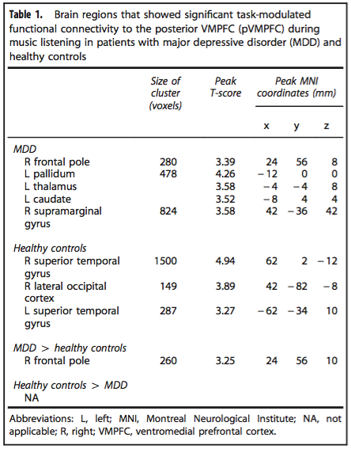
Task-modulated pVMPFC functional connectivity (with music)
In MDD: pleasant music evoked significantly greater pVMPFC connectivity with left pallidum
Stimulated activation of VP sufficient to enhance reward & motivation
Activation patterns in VP neurons specifically encode reward and motivation signals via phasic (+) bursts to incentive and hedonic stimuli
Smith, Tindell, Aldridge, & Berridge. VP Roles in Reward and Motivation. Behav Brain Res. 2009.
(Young et al., 2016)

Slide 60
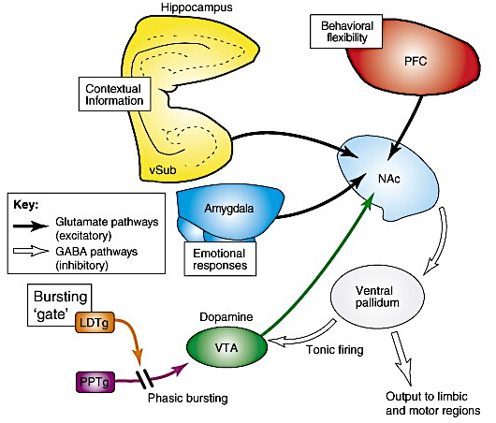
Task-modulated pVMPFC functional connectivity (with music)
In MDD: pleasant music evoked significantly greater pVMPFC connectivity with left pallidum
Stimulated activation of VP sufficient to enhance reward & motivation
Activation patterns in VP neurons specifically encode reward and motivation signals via phasic (+) bursts to incentive and hedonic stimuli
Smith, Tindell, Aldridge, & Berridge. VP Roles in Reward and Motivation. Behav Brain Res. 2009.
Grace, Floresco, Goto, & Lodge. (2007). Regulation of firing of dopaminergic neurons and control of goal-directed behaviors. Trends in Neurosci 30(5): 220-227.

Slide 61
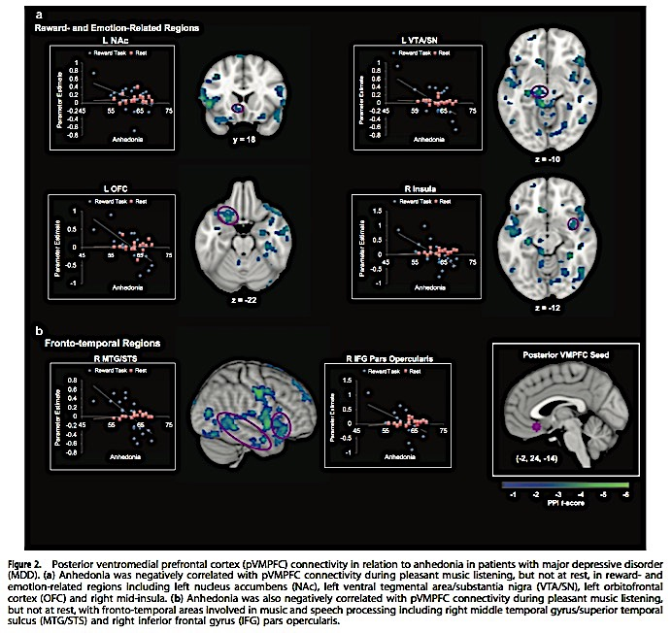
↓ pVMPFC connectivity in MDD-Anhenodia
MASQ-AD-PA: (-) correlated with pVMPFC connectivity during pleasant music listening (but not at rest) in reward- and emotion-related regions:
left nucleus accumbens (Nac)
left ventral tegmental area/substantia nigra (VTA/SN)
left orbitofrontal cortex (OFC)
right mid-insula.
No correlation with MASQ-GDD
(Young et al., 2016)
Anhedonia in MDD is associated with weak communication between pVMPFC and brain regions important for reward, emotion, and auditory processing
(Young et al., 2016)
Notes:
To fruther examine whether task-modulated functional pVMPFC connectivity patterns detected in table 2 (shown above) are sepcific to anhedonia, [they] performed ROI-based analysis using all functional clusters showing significant pVMPFC connectivity related to MASQ-AD-PA that were identified in the whole-brain analysis in either the MDD or control groups. NONE showed a significant correltiaon with MASQ-GDD

Slide 62
↓ pVMPFC connectivity in MDD-Anhenodia
↓ vmPFC → Reward Connectivity in MDD-Anhedonia:
NAc:
Detects and modulates responses to rewarding stimuli
Reward “liking” and “wanting” (Berridge et al., 2009; Pecina et al., 2008)
VTA/SNC:
Contains DA neurons central to the reward response
(Young et al., 2016)

Slide 63
↓ pVMPFC connectivity in MDD-Anhenodia
↓ vmPFC → Reward Connectivity in MDD-Anhedonia:
NAc:
Detects and modulates responses to rewarding stimuli
Reward “liking” and “wanting” (Berridge et al., 2009; Pecina et al., 2008)
VTA/SNC:
Contains DA neurons central to the reward response
Grace, Floresco, Goto, & Lodge. (2007). Regulation of firing of dopaminergic neurons and control of goal-directed behaviors. Trends in Neurosci 30(5): 220-227.

Slide 64
↓ pVMPFC connectivity in MDD-Anhenodia
↓ vmPFC → Hedonic Reward Connectivity in MDD-Anhedonia:
OFC:
OFC important for hedonic (pleasure) experience of reward
OFC: dense reciprocal connections with VMPFC
Involved in:
reward value prediction
Integration of reward cues
(Young et al., 2016)
(Barbey et al., 2009)

Slide 65
pVMPFC connectivity in MDD-Anhenodia
↓ vmPFC → OFC in MDD-Anhedonia:
OFC: dense reciprocal connections with VMPFC
OFC: sensitive to external (visual/auditory factors)
Important for pleasure experience of reward
vMPFC: sensitive to internal factors (satiety)
(Barbey et al., 2009)
Could ↓ vmPFC-OFC Connectivity cause pts to attend more to internal (pathological) stimuli than to potentially rewarding external cues?
Dysthymia/anhedonia in MDD?
Satiety/dysthymia/visceral cues/somatic markers in EDs?

Slide 66
↓ pVMPFC Connectivity to Reward Regions in MDD:
Specific to Anhedonia (vs General Distress)
(Young et al., 2016)
pVMPFC connectivity during the pleasant music listening task dissociates anhedonia from general distress in patients with MDD. Strength of partial correlations between pVMPFC connectivity and anhedonia shown after controlling for: age and general distress (solid lines) or age and anhedonia (dashed lines). Red: links significant for anhedonia after controlling for general distress and age and correcting for multiple comparisons. (*P<0.05, FDR corrected).

Slide 67
↓ pVMPFC Connectivity to Reward Regions in MDD:
Specific to Anhedonia (vs General Distress)
(Young et al., 2016)
pVMPFC connectivity during resting state did not dissociates anhedonia from general distress in either group. Strength of partial correlations between pVMPFC connectivity and anhedonia shown after controlling for: age and general distress (solid lines) or age and anhedonia (dashed lines). Red: links significant for anhedonia after controlling for general distress and age and correcting for multiple comparisons. (*P<0.05, FDR corrected).

Slide 68
pVMPFC connectivity in MDD-Anhenodia
↓ vmPFC → Frontotemporal (Auditory) Connectivity in MDD-Anhedonia:
Right middle temporal gyrus/superior temporal sulcus (MTG/STS)
Right inferior frontal gyrus (IFG) pars opercularis
Both track & process elements of sound/music
Interact with mesolimbic reward system
(Young et al., 2016)

Slide 69
pVMPFC connectivity in MDD-Anhenodia
↓ vmPFC → Frontotemporal (Auditory) Connectivity in MDD-Anhedonia:
Anhedonia may disrupt the ability to experience pleasure from positive auditory stimuli (like music) which requires successful integration of sensory perception with reward-related cognitive and evaluative processes
Inability to engage with positively valenced music stimuli
Both groups rated the music as pleasant
MDD pt’s are not impaired at rating pleasantness of musical stimuli, but may experience pleasurable stimuli differently
(Young et al., 2016)

Slide 70
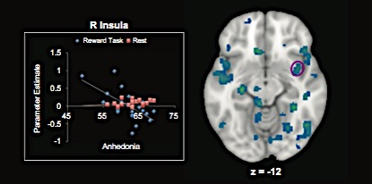
pVMPFC connectivity in MDD-Anhenodia
↓ vmPFC → Frontotemporal (Auditory) Connectivity in MDD-Anhedonia:
Anhedonia may disrupt the ability to experience pleasure from positive auditory stimuli (like music) which requires successful integration of sensory perception with reward-related cognitive and evaluative processes
Could reduced vmPFC connectivity to taste processing regions (gustatory cortex: anterior insula, frontal operculum) disrupt ability to experience pleasure from positive gustatory stimuli (like food) for patients with eating disorders? Or alter taste stimuli experience?
(Young et al., 2016)

Slide 71
↓ Activity-Dependent pVMPFC Connectivity in MDD-Anhedonia
Anhedonia was differentially associated with pVMPFC connectivity:
when processing pleasant musical stimuli
but not during rest
Specific to music (not scrambled stimuli)
Anhedonia reflects a lack of engagement between pVMPFC and reward-related functional circuits:
When encountering pleasurable stimuli
(vs constant static deficit in connectivity)
(Young et al., 2016)
Strength of partial correlations between pVMPFC connectivity and anhedonia shown after controlling for: age and general distress (solid lines) or age and anhedonia (dashed lines). Red: links significant for anhedonia after controlling for general distress and age and correcting for multiple comparisons. (*P<0.05, FDR corrected).

Slide 72
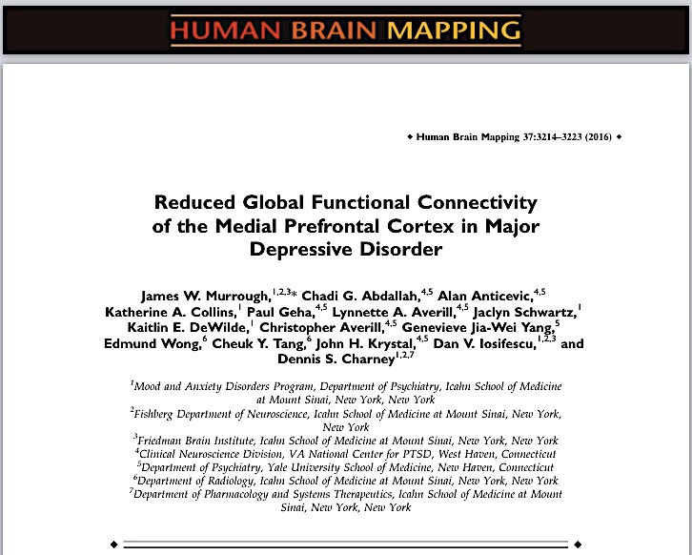

Slide 73
MDD:
Pervasive disturbances in:
Mood regulation
Reward sensitivity
Cognitive control
Neurovegetative functioning
http://i.huffpost.com/gen/2063534/images/o-DEPRESSION-facebook.jpg
Notes:
Neurovegetative sx:
distrubances of person’s functions necessary to maintain life (vegetative functions):
Weight loss and anorexia (loss of appetite)
Insomnia
Fatigue and low energy
Inattention

Slide 74
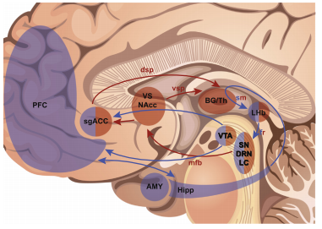
MDD:
Disordered functioning in distributed neural systems:
Ventral, medial, & lateral PFC
Rostral & ventral ACC
Interconnected subcortical regions
vmPFC & sgACC: prominent models of depression
https://sites.tufts.edu/emotiononthebrain/files/2014/11/Untitled.png

Slide 75
sgACC Dysfunctioning in Depression
ACC: Anterior Cingulate Cortex
Emotion modulation
sgACC: subgenual ACC
↓ gray matter volume in MDD
↓ glia, not neurons
↑ metabolic activity in MDD
Antidepressants ↓ sgACC activity
sgACC deep brain stimulation ↓ MDD
https://sites.tufts.edu/emotiononthebrain/files/2014/11/Untitled.png
(Drevets, Savitz, & Trimble. The sgACC in mood disorders. CNS Spectr. 2008)

Slide 76
Current Research Limitations:
Reliance on a priori selection of “seed” regions
Restricts interpretation of results
Doesn't provide comprehensive method for examining connectivity outside of ROIs
https://sites.tufts.edu/emotiononthebrain/files/2014/11/Untitled.png

Slide 77
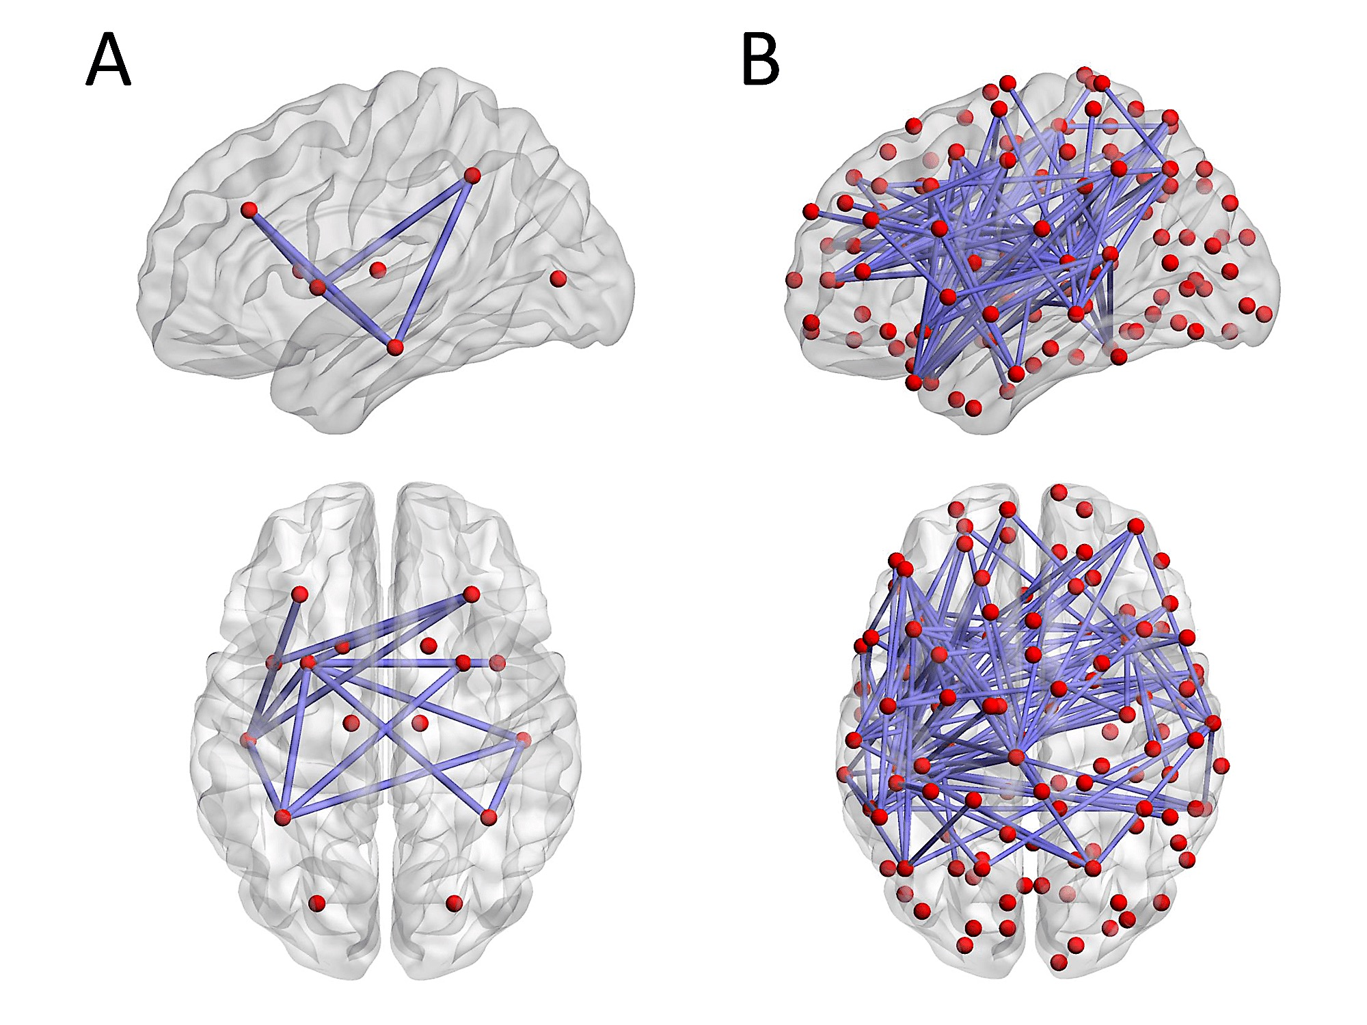
Global Brain Connectivity
Based on graph theory
Measures connectivity of all voxels in brain relative to all other voxels
Data-driven approach
Powerful, replicable biomarker to identify major intrinsic brain networks that
correlate with normal brain functions
and are disrupted in disorders
https://sites.tufts.edu/emotiononthebrain/files/2014/11/Untitled.png
Hong, Zalesky, Cocchi, Fornito, Choi, Kim, Suh, Kim, Kim, & Yi. PLoS One. 2013. http://yourbrainonporn.com/decreased-functional-brain-connectivity-adolescents-internet-addiction-2013
Notes:
Voxel ~ 3D unit used in fMRI brain mapping
“(in computer-based modeling or graphic simulation) each of an array of elements of volume that constitute a notional three-dimensional space, especially each of an array of discrete elements into which a representation of a three-dimensional object is divided.”

Slide 78
Participants:
Outpatient Recruitment
Ensures MDD Diagnosis
Major Depressive Disorder (MDD, n=51)
29 (57%)♀, 22 (43%)♂
Healthy Controls (HC, n=25)
12 (48%)♀, 13 (52%)♂
Free of psychotropic medications for ≤ 1 wk p/t scan
Includes SSRIs, SNRIs, tricyclics
Pre-Scan Depression Assessment :
Montgomery-Åsberg Depression Rating Scale (MADRS)
Hamilton Anxiety Rating Scale (HAM-A)
http://i.huffpost.com/gen/2063534/images/o-DEPRESSION-facebook.jpg

Slide 79
Methods:
Outpatient Recruitment
Ensures MDD Diagnosis
Major Depressive Disorder (MDD, n=51)
29 (57%)♀, 22 (43%)♂
Healthy Controls (HC, n=25)
12 (48%)♀, 13 (52%)♂
Free of psychotropic medications for ≤ 1 wk p/t scan
Includes SSRIs, SNRIs, tricyclics
9 participants required “washout”
Pre-Scan Depression Assessment :
Montgomery-Åsberg Depression Rating Scale (MADRS)
Hamilton Anxiety Rating Scale (HAM-A)
MRI Scan
Total resting state acquisition: 4 min
Preprocessing: brain extraction, motion correction, slice-time correction, spatial smoothing
BOLD quality criteria: signal-to-noise ratio >100, no single frame movements > 1 functional voxel
Remove spurious signals: regression of 6 rigid-body motion parameter, CSF, white matter, global brain signal out of each voxel’s time series
Processing & Analysis:
Global signal regression
Global Brain Connectivity (GBC)

Slide 80
Methods:
Whole brain analysis: Global Brain Connectivity
Compute Pearson correlation between given voxel’s time series and every voxel’s time series
Transform all correlations to Fisher z-values
Compute mean across Fisher z-values (Fz)
Generates map for each subject
Each voxel value represents mean connectivity of that voxel with the rest of the brain
Individual maps entered into between group t-test (MDD vs HC)
Co-varying for age and gender
Whole brain analyses followed by ROI analyses
Restricted to vmPFC
Relationships between GBC and MDD sx severity examined by linear correlation

Slide 81
Whole-brain Global Connectivity in MDD
(Murrough et al., 2016)

Slide 82
MDD: ↓ GBC in sgACC and BL vmPFC
(Murrough et al., 2016)

Slide 83
MDD: ↓ GBC in sgACC and BL vmPFC
vmPFC
sgACC
Left: Clusters where MDD showed significantly less GBC vs healthy controls (HC). Right: Clusters of significant dysconnectivity in MDD (vs HC) in the medial prefrontal cortex and subgenual anterior cingulate (Morrough et al., 2016).

Slide 84
MDD: ↓ GBC in sgACC and BL vmPFC
Subgenual Anterior Cingulate Cortex (sgACC)
↓ gray matter volume in MDD
Regulates emotional behavior & stress response
Participates in extended “visceromotor network”
that modulates autonomic/neuroendocrine responses
And neurotransmitter release
During neural processing of reward, fear, & stress
(Murrough et al., 2016)
Right: Drevets, Savitz, & Trimble. (2008). The subgenual anterior cingulate cortex in mood disorders. CNS Spectr 13(8).

Slide 85
MDD: ↓ GBC in sgACC &vmPFC; altered DMN
vmPFC and sgACC: key regions in DMN and salience network
DMN: Default mode network
Supports internally directed and self-referential thought
Implicated in pathological rumination in MDD
(Murrough et al., 2016)
Right: Drevets, Savitz, & Trimble. (2008). The subgenual anterior cingulate cortex in mood disorders. CNS Spectr 13(8).

Slide 86
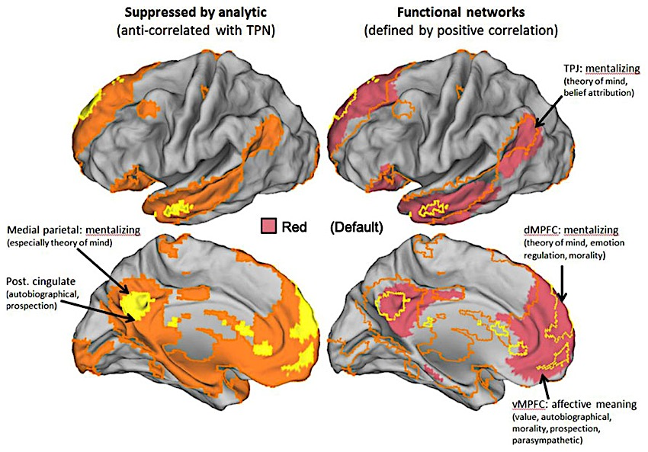
MDD: ↓ GBC in sgACC &vmPFC; altered DMN
vmPFC and sgACC: key regions in DMN and salience network
DMN: Default mode network
Supports internally directed and self-referential thought
Implicated in pathological rumination in MDD
Figure (Left): Boyatzis, Rochford, & Jack. (2014). Antagonistic neural networks underlying differential leadership roles. Front Hum Neurosci 8:114.
Right (Text): Drevets, Savitz, & Trimble. (2008). The subgenual anterior cingulate cortex in mood disorders. CNS Spectr 13(8).

Slide 87
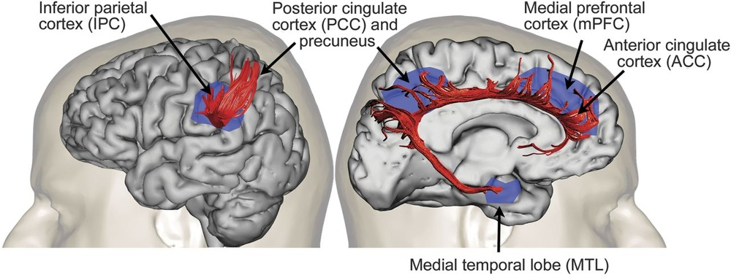
Default Mode Network (DMN)
http://cargocollective.com/ACIDMATH/ARTICLE-Turning-off-the-Default-Mode-Network-Transcending-the-Self

Slide 88
MDD: ↓ GBC in sgACC &vmPFC; altered DMN
↓GBC of sgACC & vmPFC:
Consistent with pathological autonomy of DMN hub
Functional consequences:
dominating self-referential mental processes
Resistance to regulation by cognitive control systems
Figure (Left): Boyatzis, Rochford, & Jack. (2014). Antagonistic neural networks underlying differential leadership roles. Front Hum Neurosci 8:114.
Right (Text): Drevets, Savitz, & Trimble. (2008). The subgenual anterior cingulate cortex in mood disorders. CNS Spectr 13(8).

Slide 89
MDD: ↓ GBC in sgACC &vmPFC; altered DMN
Functional consequences:
dominating self-referential mental processes
Resistance to regulation by cognitive control systems
Could this mechanism drive “pathological concerns” that cause ED patients to “[ignore] long-term negative consequences” (in IGT and in pathological behaviors), leading to impaired decision-making (Matsumoto et al., 2016)?
Figure (Left): Boyatzis, Rochford, & Jack. (2014). Antagonistic neural networks underlying differential leadership roles. Front Hum Neurosci 8:114.
Right (Text): Drevets, Savitz, & Trimble. (2008). The subgenual anterior cingulate cortex in mood disorders. CNS Spectr 13(8).

Slide 90
MDD: ↓ GBC in bilateral vmPFC
GBC within the vmPFC in MDD (A) and association with sx severity (B)
Cluster depicts significantly reduced GBC in MDD (vs healthy controls, HC) within an anatomically defined bilateral VMPFC
Inverse linear correlation between GBC within the VMPFC and depressive severity based on Montgomery-Åsberg Depresion Rating Scale score (MADRS).
(Murrough et al., 2016)

Slide 91
MDD: ↓ GBC in bilateral vmPFC
↓vmPFC GBC Consistent with:
↓ cognitive flexibility
↓ concentration
↓ emotion regulation capacity
All associated with MDD (Gotlib & Joormann, 2010; Murrough et al., 2011 as cited in Murrough et al., 2016)
And EDs (Motsumoto et al., 2016; Aloi et al., 2016, etc)
(Murrough et al., 2016)

Slide 92
Does aberrant vmPFC connectivity alter decision-making in eating disorders?
Contributing to increased attendance to “pathological concerns,”
and decreased attendance to long-term negative consequences
resulting in failure to learn (persistent impaired decision-making)?
Altered connectivity between vmPFC and:
OFC
sgACC
Altered connectivity/activity in DMN
Altered decision-making regarding food and eating?
(Barbey et al., 2009)

Slide 93
Does aberrant vmPFC connectivity alter decision-making in eating disorders?
Do patients with eating disorders show reduced vmPFC connectivity:
At rest?
While eating?
While viewing food images?
Does vmPFC connectivity correlate with decision-making in EDs?
Iowa Gambling Task Score

Slide 94
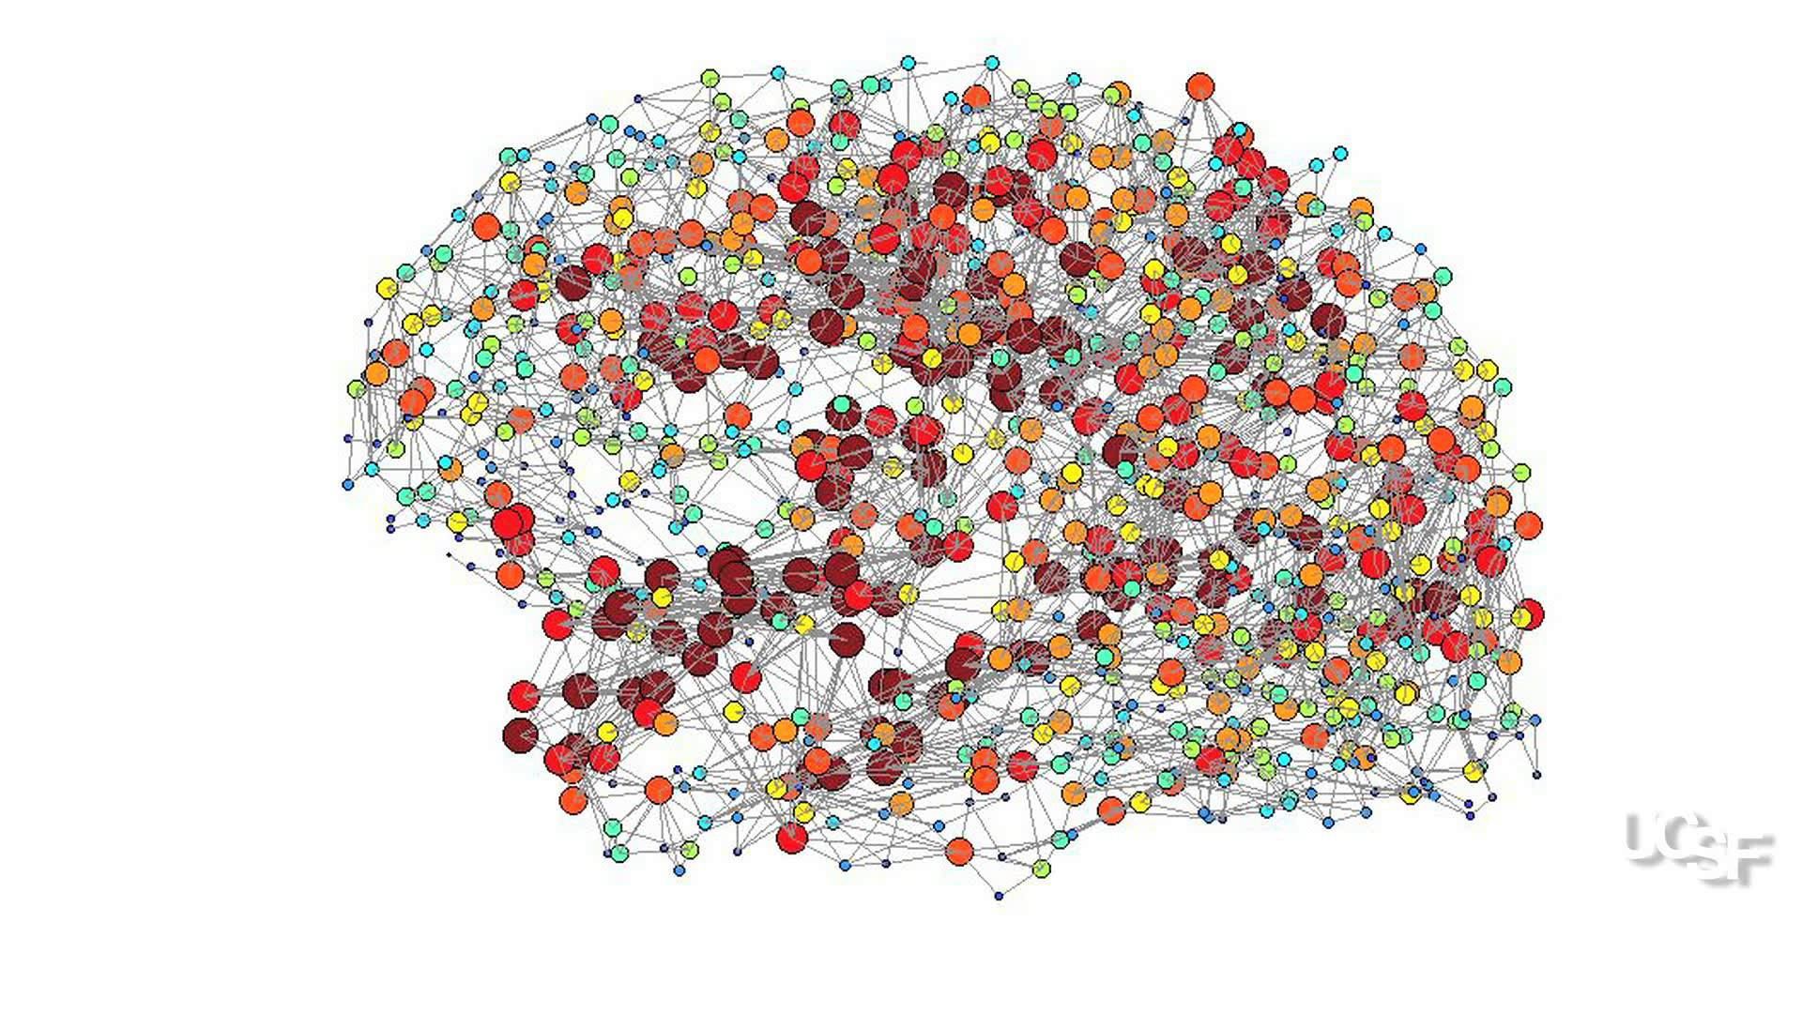
https://i.ytimg.com/vi/_M3h5DQvMao/maxresdefault.jpg

Slide 95
Reduced decision-making ability and learning in Bulimia Nervosa
Matsumoto et al. Comparison in decision-making between BN, AN, and HC… J Eating Disorders (2015) 3:14

Slide 96
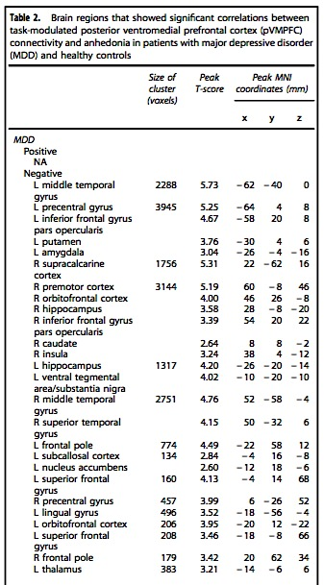
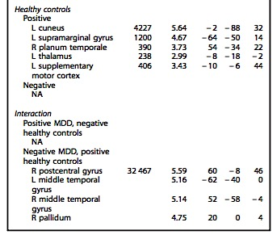
(-) Correlation between pVMPFC Connectivity & MASQ-AD-PA in MDD
Brain regions with significant correlations between task-modulated pVMPFC connectivity and MASQ-AD-PA in MDD & HC
↑ vmpFC connectivity
in anhedonia
↓ vmpFC connectivity
in anhedonia
Young et al., 2016

